Slide 1
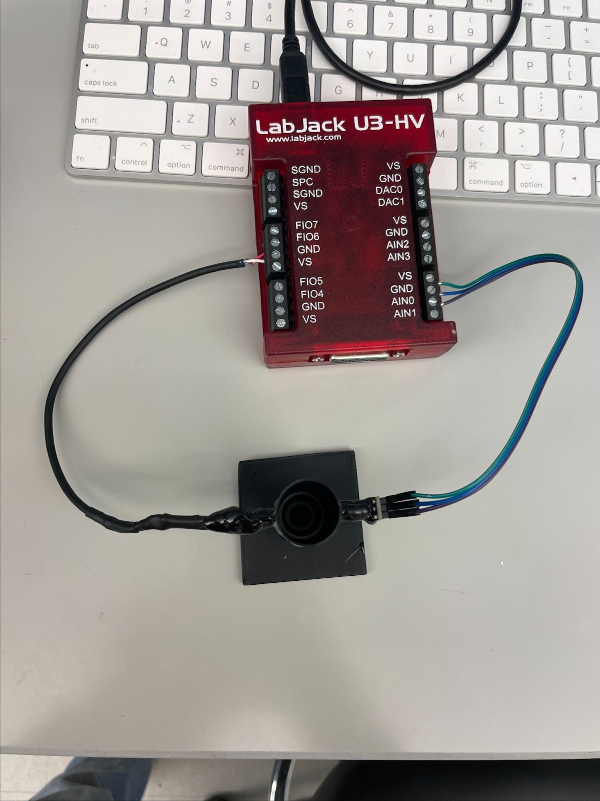
Optical Density Sensor

Slide 2
About
Cable to Computer
This sensor can measure the optical density of media in Hungate (or similar diameter) tubes
The sensor works by shining an LED through the Tube holder to a Photosensor on the opposing side.
Tube Holder
Photosensor
LED

Slide 3
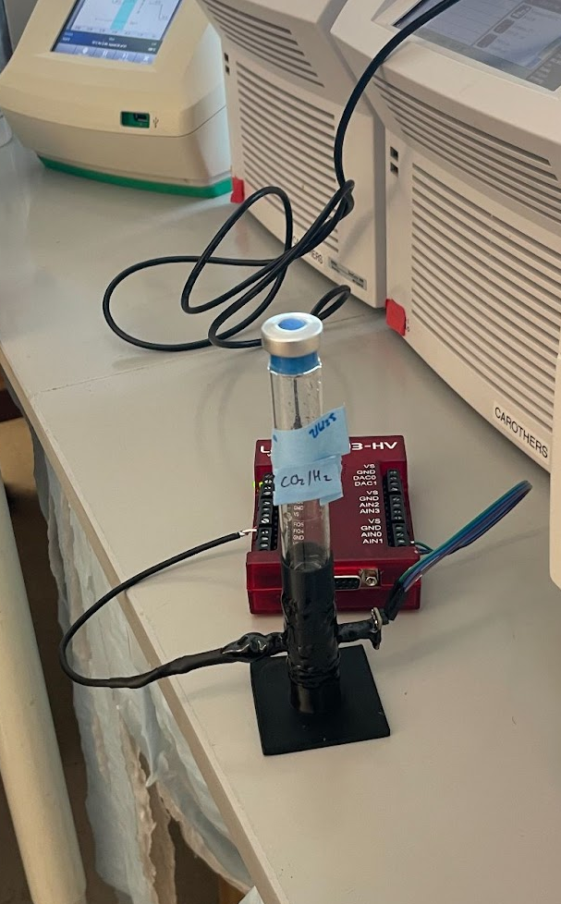
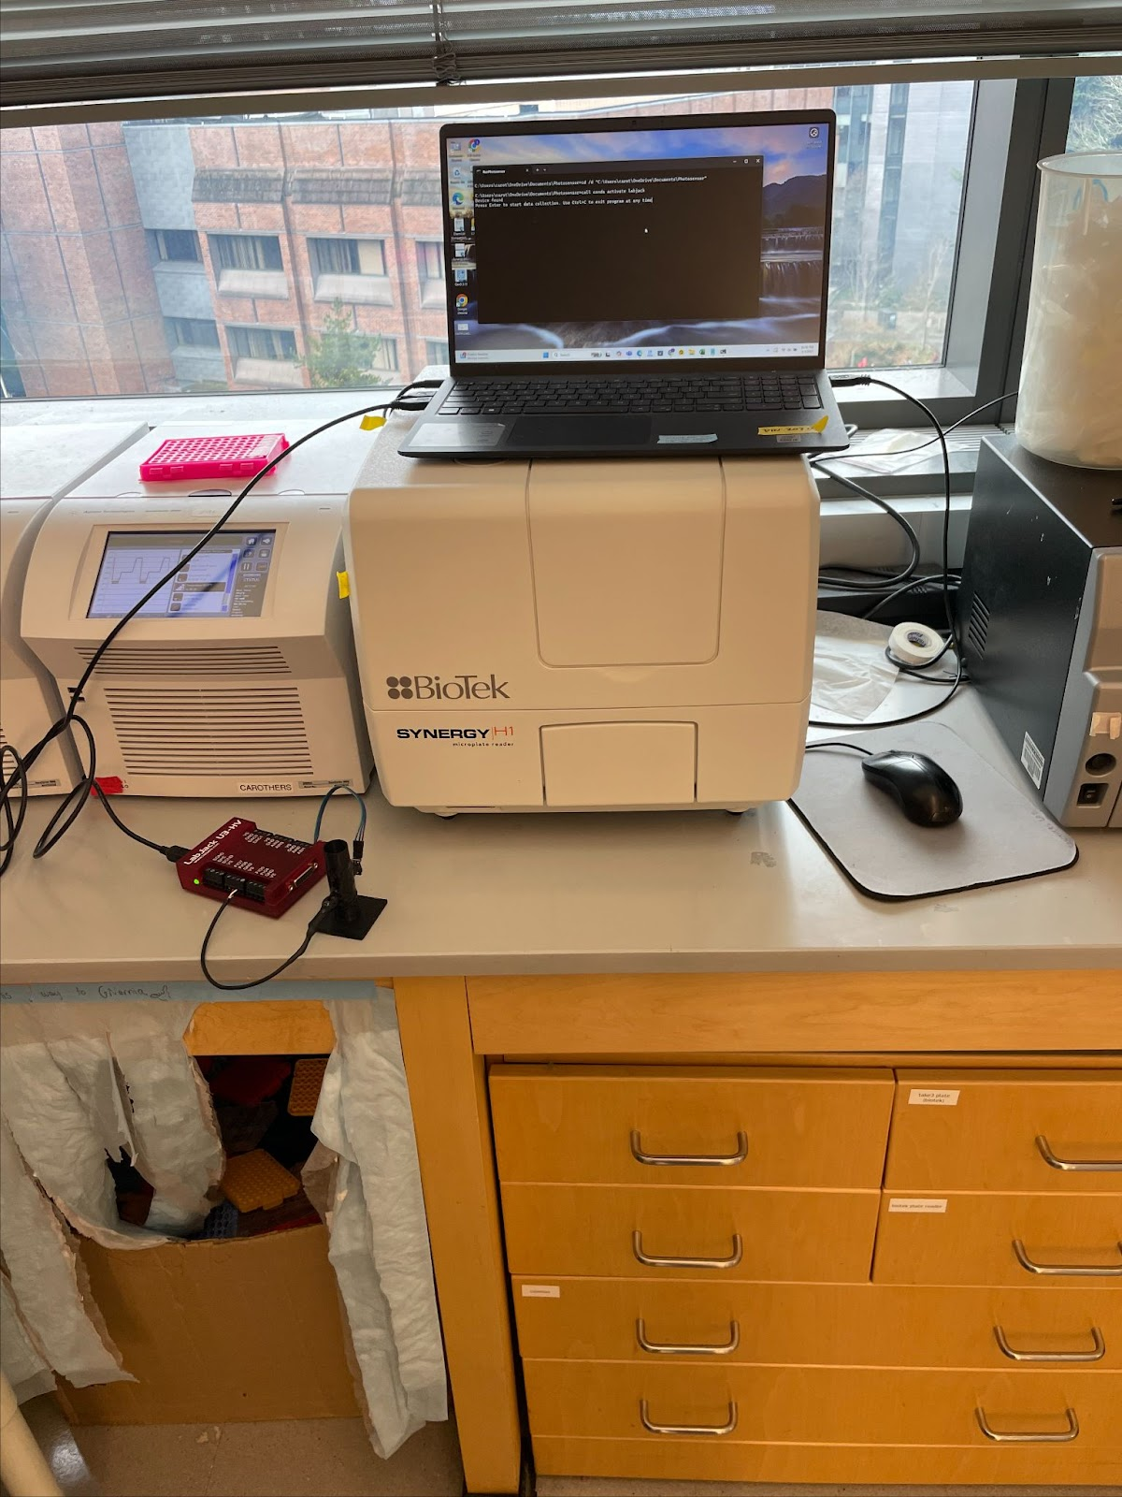
Sensor in use
Full sensor set up on lab computer

Slide 4
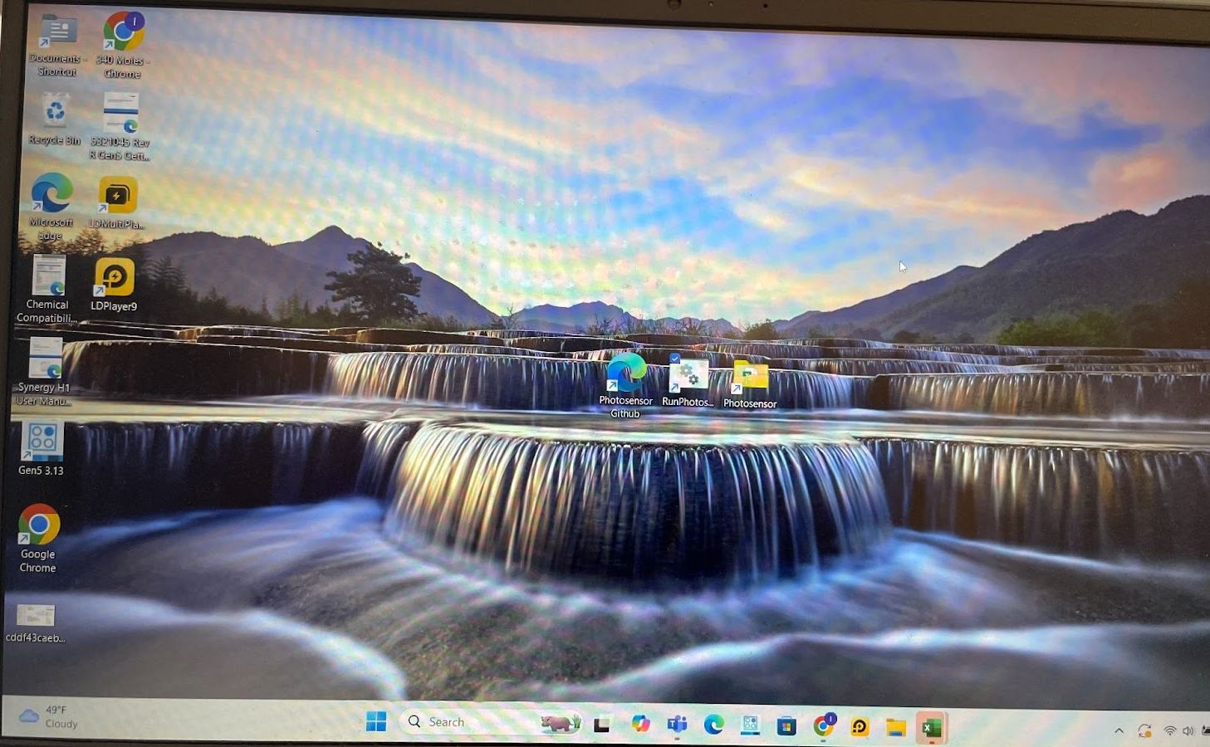

Starting Sensor
Run this file
Plug USB cable into lab computer by spectrophotometers
Wont work on other computers as software currently only installed on this one
Launch RunPhotosensor from desktop

Slide 5
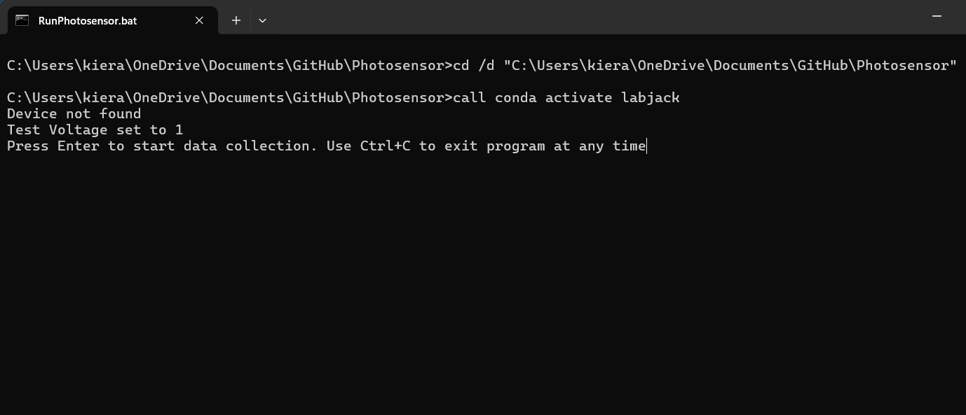
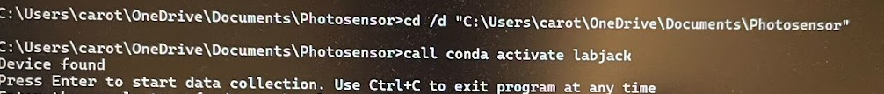
Interface
Following will pop up
Press Enter to start program
Use Ctrl + C to abort program at any time
Warning aborting program will delete all saved data
Replace with device plugged in opening screen to avoid Confusion!!

Slide 6
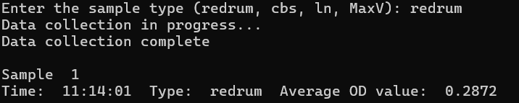
User prompted for sample type
All available sample types are listed within parathesis
If new sample type, enter name followed by calibration equation (see ‘Adding New Sample’ slide)
When sample type entered data collection will begin. Sensor takes readings every 0.1 s for 5 s then returns an average OD
When data collection complete computer will print info
This data is saved so no need to write down values manually
Data can be exported as a csv file once sampling is complete

Slide 7
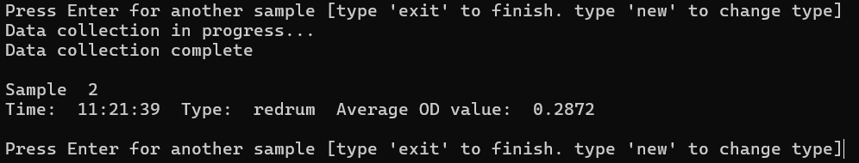
User is now asked if they want to take another sample
enter collects another reading of the same sample type
‘new’ changes the sample type
‘exit’ ends data collection and prompts to save data
User asked if they want to save data as csv
System will continuously ask for new samples until user want to exit
Will ask user for new sample name

Slide 8
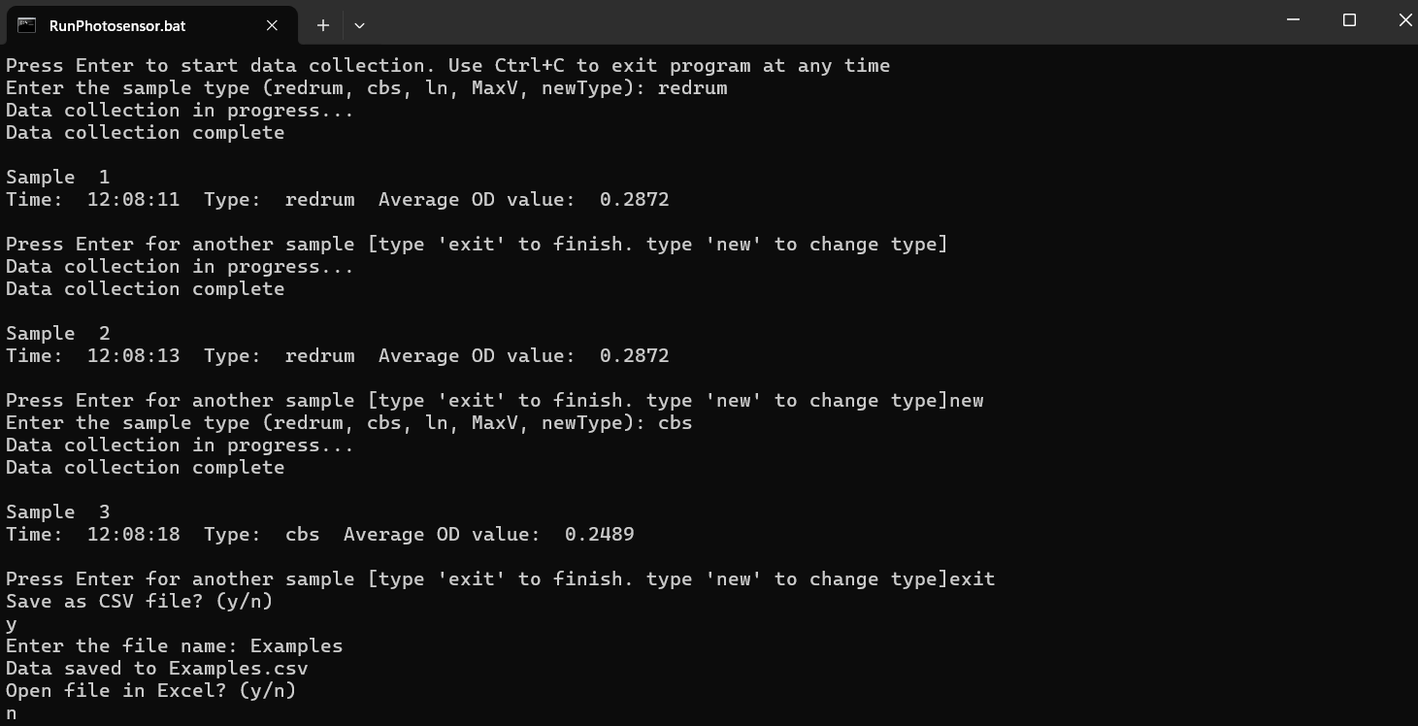
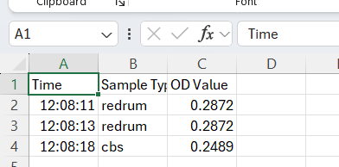
Example Code
Spreadsheet output

Slide 9
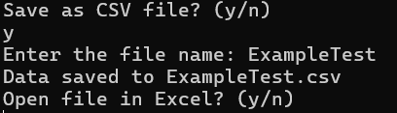
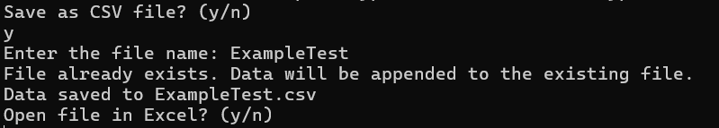
Saving
When saving user will be asked for file name
If new file name entered then a csv of the same name will be created
If file name matches exiting csv file name then data will be appended to the bottom of that sheet
For convenience user can directly open csv file in excel from program
Saving data to csv
Saving data to exiting csv

Slide 10
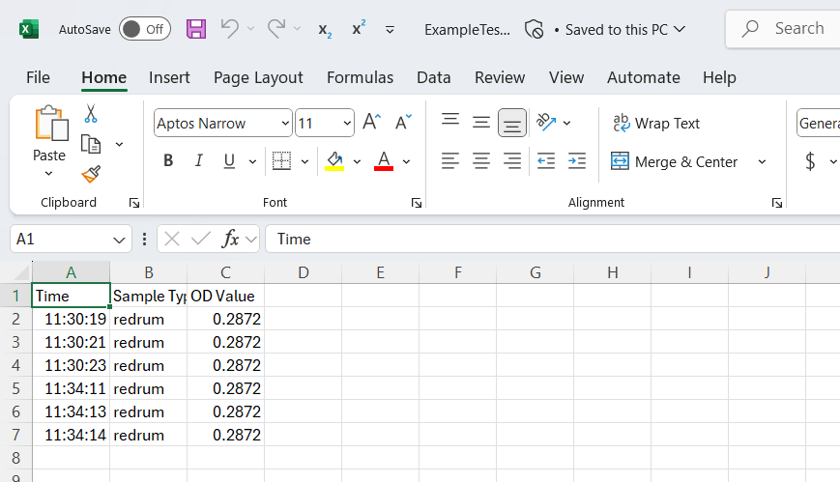
CSV file is saved to Photosensor folder
Shortcut on desktop
To the right is an example of how saved data appears in excel
Save Location

Slide 11
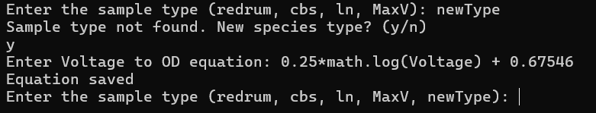
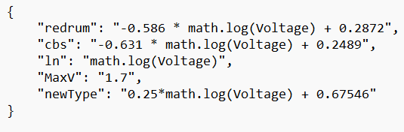
Adding New Sample Type
To add new sample either:
Enter new sample name in program
Will be asked if new sample and then to enter calibration equation
Equation must use ‘Voltage’ as voltage variable name
Sample type is now accessible when choosing type
This method will save new sample and equation to Equations.json
Or:
Input name and equation in Equations.json file
Equations.json is saved in Photosensor folder
Open with notepad to easily edit
See right image for name and equation syntax
Equations.json opened with Notepad

Slide 12
Calibration Equation
Calibration equations found by creating 3 5x dilutions of species
Then get sensor voltage values of dilutions using Calibration.py file
Coming soon to GitHub (Use continuous readings.py for time being)
Get OD of dilutions using lab spectrophotometer
Graph these against each other in Excel with OD on y axis and Voltage on the x axis
Use logarithmic trendline to get calibration equation for the species
Logarithmic usually most accurate with R^2 ~ 0.98
Linear may work as well
Enter equation in Equation.json or through RunPhotosensor program
See existing equations for syntax
Must use math.log(Voltage) for ln(Voltage) when entering calibration equation
See Ryan, Diego, or Kieran if need help

Slide 13
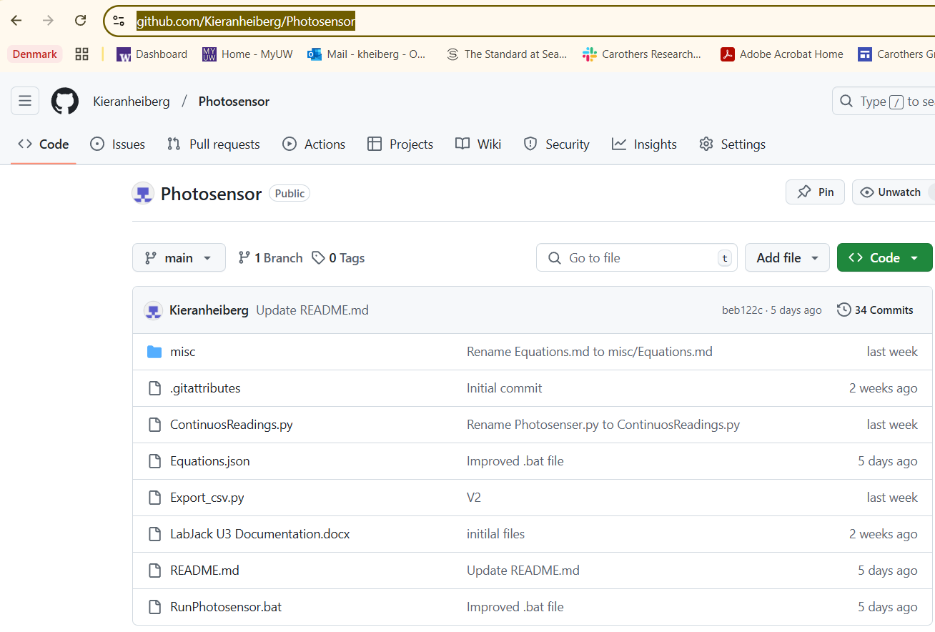
Additional Info
More detailed instructions in ReadMe file in GitHub
Linked on computer desktop
https://github.com/Kieranheiberg/Photosensor
Sensor is usually stored by Ryan’s bench
Slack Kieran Heiberg for questions
Can also talk to Ryan and Diego as they are familiar with sensor
Currently working on a case so sensor may soon be housed in black box
If want to run sensor on different computer, set up instructions in GitHub

Slide 14
Improvements
If you have any suggestions for new features or improvements, please slack me (Kieran)
Currently working on expanding sensor to fit different types of sample containers
Also working to set up autonomous continues readings using Arduino

